Slide 1
v2.0 — 2026
THE INSTANT DESTROYER
TID
TID Diagrams — Complete Visual Reference
Physical destruction of sensitive data from memory and cache
Linux Kernel Module — Highest software-level security
AMD EPYC 9B14 — Linux 6.14.11
ORCID: 0009-0001-4360-0802
Ahmad Qasim Mohammad Hassan

Slide 2
1 / 10
Diagram 1 — TID System Architecture
Architecture
Operation flow from the application layer down to main memory
Application (App)
Password / Encryption Key / Sensitive Data
ioctl() — System Call
▼
TID Kernel Module — Linux Kernel Module
CLFLUSHOPT
REP STOSQ
LFENCE
Flush Cache Lines
→
Zero-fill Memory
→
Execution Barrier
~130ns
~50ns
~40ns
▼
MFENCE + LFENCEGuarantee completion of all operations
RAM
L3 Cache
L2 Cache
L1 Cache
Zeroed ✓
Empty ✓
Empty ✓
Empty ✓
Ahmad Qasim Mohammad Hassan
TID v2.0

Slide 3
2 / 10
Diagram 2 — PROTECT+ZERO Protocol
Sensitive data lifecycle — three phases
ZERO Phase
Data in Use
PROTECT Phase
After data use
Key / Password / Data
Before data use
Block speculation againLFENCE
Attack Window
LFENCEBlock speculative execution
Write zeros to memoryREP STOSQ
→
372 ns
→
Evict cache L1+L2+L3CLFLUSHOPT
MFENCEEnsure prior writes complete
Ensure flush completionMFENCE
Physical hardware minimum
Close the second sideLFENCE
✓ Attacker finds nothing
✓ Cache fully empty
✓ Memory is clean
Ahmad Qasim Mohammad Hassan
TID v2.0

Slide 4
3 / 10
Diagram 3 — Attack Timeline
TID window: 372ns — Attacker measurement interval: 112ns
372ns ✓
340ns
300ns
260ns
180ns
100ns
50ns
0ns
TID executing
LFENCE
MFENCE
CLFLUSHOPT
REP STOSQ
LFENCE
40ns
40ns
~130ns
50ns
40ns
Attacker attempting
Finds nothing
Probe 3
Probe 2
Probe 1
112ns
112ns
112ns
Ratio
3.7×
→
Result
→
Cache state
→
Attacker measures
Attack failed ✓
Completely empty
Gets 286 cycles
286 ÷ 78
Ahmad Qasim Mohammad Hassan
TID v2.0

Slide 5
4 / 10
Diagram 4 — Cache Comparison: Before and After TID
Three scenarios — No protection / TID v1 / TID v2
✓ TID v2.0
⚠ TID v1.0
✗ No TID
Cache Layer
░░░░ (fully empty)
0xAB... (key present)
0xAB... (key present)
L1 Cache
░░░░ (fully empty)
0xAB... (key present)
0xAB... (key present)
L2 Cache
░░░░ (fully empty)
Zeroed (partial wipe)
0xAB... (key present)
L3 Cache
Nothing ✓ Secure
Partial data ✗
The data ✗ Danger
Attacker finds
* v1.0 wipes main memory but leaves cache populated — the vulnerability remains exploitable via Flush+Reload
Ahmad Qasim Mohammad Hassan
TID v2.0

Slide 6
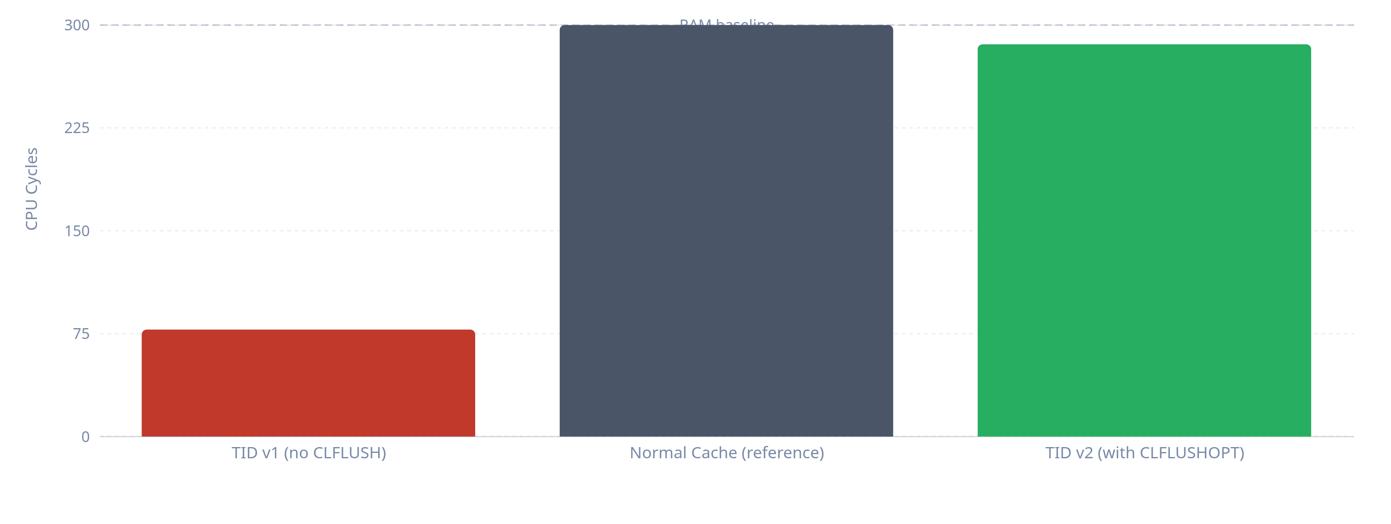
5 / 10
Diagram 5 — Performance Comparison
CPU cycles to access data — More cycles = More secure
TID v1 — Cache HIT
78 cycles
Direct leak ✗
Improvement ratio
3.7×
286 ÷ 78
TID v2 — Cache MISS
286 cycles
Attack blind ✓
Attacker hits RAM not cache — attack fails
Ahmad Qasim Mohammad Hassan
TID v2.0

Slide 7
6 / 10
Diagram 6 — TID vs Existing Libraries
Security capabilities across industry solutions
Verdict
LFENCE Barrier
CLFLUSH Flush
Safe Memory Wipe
Library / Solution
Unreliable
✗
✗
✗ *compiler may remove
memset()
Partial
✗
✗
✓
explicit_bzero()
Partial
✗
✗
✓
memzero_explicit()
Partial
✗
✗
✓
OPENSSL_cleanse()
Partial
✗
✗
✓
sodium_memzero()
Best software ✓
✓
✓
✓
► TID v2.0 ◄
Requires dedicated hardware
Automatic ✓
Automatic ✓
✓
Intel SGX (hardware)
* memset() is optimized away by the compiler in many cases — a documented C/C++ vulnerability
Ahmad Qasim Mohammad Hassan
TID v2.0

Slide 8
7 / 10
Diagram 7 — Statistical Key Reconstruction Attack
Flush+Reload attack — TID v1 vs TID v2
Phase 2 — TID v2
Phase 1 — TID v1
Cache always empty — attack fails
Cache not flushed — attack succeeds
Slot 13
Slot 133
Slot 87
Slot 42
Probe
Slot 13
Slot 133
Slot 87
Slot 42
Probe
✗ empty
✗ empty
✗ empty
✗ empty
Probe 1
✗ absent
✓ present
✓ present
✓ present
Probe 1
✗ empty
✗ empty
✗ empty
✗ empty
Probe 500
✗ absent
✓ present
✓ present
✓ present
Probe 500
✗ empty
✗ empty
✗ empty
✗ empty
Probe 1000
✗ absent
✓ present
✓ present
✓ present
Probe 1000
Statistical accumulation
Statistical accumulation
0/1000
0/1000
0/1000
0/1000
3/1000
978/1000
991/1000
987/1000
no pattern
no pattern
no pattern
no pattern
not in key
key fragment
key fragment
key fragment
No pattern — No key — Attack failed ✓
Key reconstructed byte by byte ✗
Cache empty — nothing to measure
Successful attack on TID v1
Ahmad Qasim Mohammad Hassan
TID v2.0

Slide 9
8 / 10
Diagram 8 — Security Solution Ladder
Weakest to strongest — solution ranking
Intel SGX / AMD SEV
①
Automatic ✓
Cache flush
Dedicated hardware — Encrypted cache — Zero attack window
Dedicated Hardware
← You are here
②
Explicit ✓
► TID v2.0 ◄
Cache flush
Wipe + CLFLUSHOPT + LFENCE/MFENCE — highest software level without dedicated hardware
Best Software
libsodium / OpenSSL / glibc
③
✗ Missing
Cache flush
Safe wipe of main memory only
Partial Software
memset() standard
④
✗ Missing
Cache flush
Compiler may remove — no actual guarantee
Unreliable
TID v2.0 is the maximum achievable in software without dedicated hardware — proven experimentally
Ahmad Qasim Mohammad Hassan
TID v2.0

Slide 10
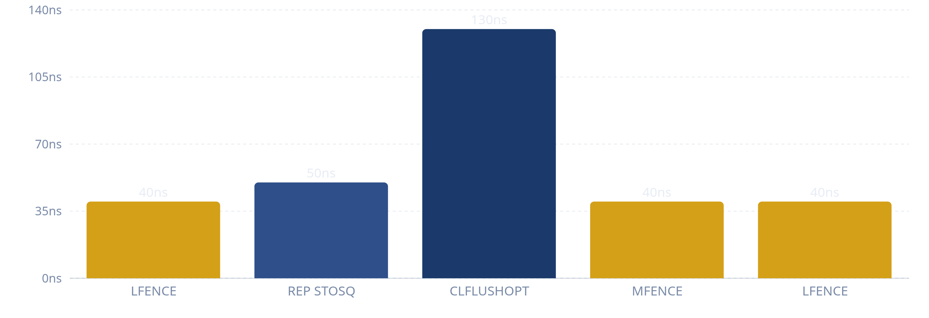
9 / 10
Diagram 9 — Physical Minimum Latency of TID
Per-instruction timing — a physical constraint of the CPU itself
LFENCE
Time in nanoseconds (ns)
~40ns
Execution barrier — blocks speculative execution
Position: Start
~50ns
REP STOSQ
Write zeros — wipe main memory
Position: Wipe
~130ns
CLFLUSHOPT
Evict cache lines from L1/L2/L3
Position: Cache flush
MFENCE
Total
~40ns
Guarantee all operations complete
300–372 ns
Position: Completion
LFENCE
Physical hardware minimum — proven experimentally
~40ns
Close the second side
Position: End
The constraint is CPU physics itself, not code efficiency — measured value: 290–372ns
Ahmad Qasim Mohammad Hassan
TID v2.0

Slide 11
10 / 10
Diagram 10 — Experimental Proof Summary
AMD EPYC 9B14 | Linux 6.14.11 | GCC 14.3.0 | 2599 MHz | 62.8 GiB RAM | -O2 -mclflushopt
5,000 samples
Test 3
10,000 samples
Test 2
1,000 samples
Test 1
CPU Shield
Timing Window
Basic Attack
CPU Hardening
Timing Window
Flush+Reload
CPU Affinity✓
TID window372ns
Ratio
v2
v1
3.7×
286
78
mlock✓
Attacker probe112ns
cycles
cycles
SCHED_FIFOrequires root
Possible probes3.3 only
Experimentally Verified Final Result
Maximum achievable in software without SGX/SEV
Attacker measures and finds zero — no pattern — no key
TID v2.0 defeats Flush+Reload after use
Ahmad Qasim Mohammad Hassan
TID v2.0

Slide 12

THE INSTANT DESTROYER
Security Level
Protection Ratio
Destruction Window
②
3.7×
372ns
Maximum software level
Attacker access overhead
Physical hardware minimum
Ahmad Qasim Mohammad Hassan
TID Project — 2026
ORCID: 0009-0001-4360-0802
Cache empty — Memory clean — Attacker finds nothing

